Slide 1


LOWER LIMB
ACTIVE ASSISTED ROM

Slide 2
Presented by
Abdulrahman Khalil
Abdulrahman Elsherbeny
Abdulrahman Shehata
Abdelfattah Elbadry
Abdullah Beiet
Zeyad Mahmoud
Abdulrahman Temraz
AbdelMoneim Sameh

Slide 3
SUBTITELS
How to make sufficient AAROM
Indication
Multiple scerlosis
Example about self assisted
Case study about self assisted
Mechanical assisted
Contra-indication Case study about therapeutic assisted Questions

Slide 4
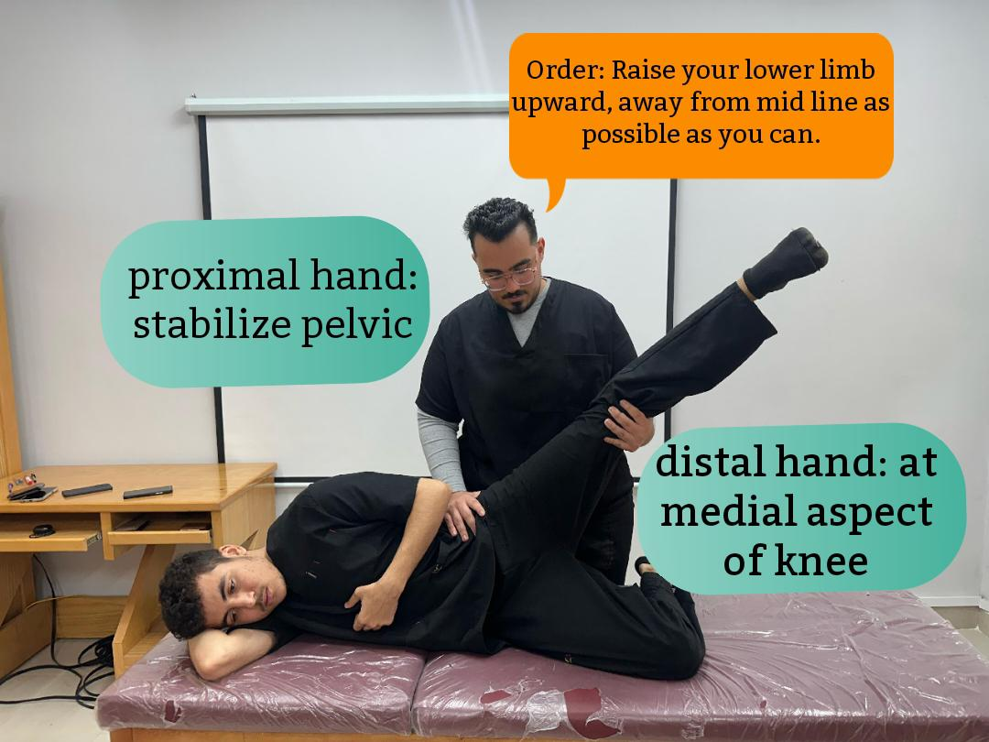
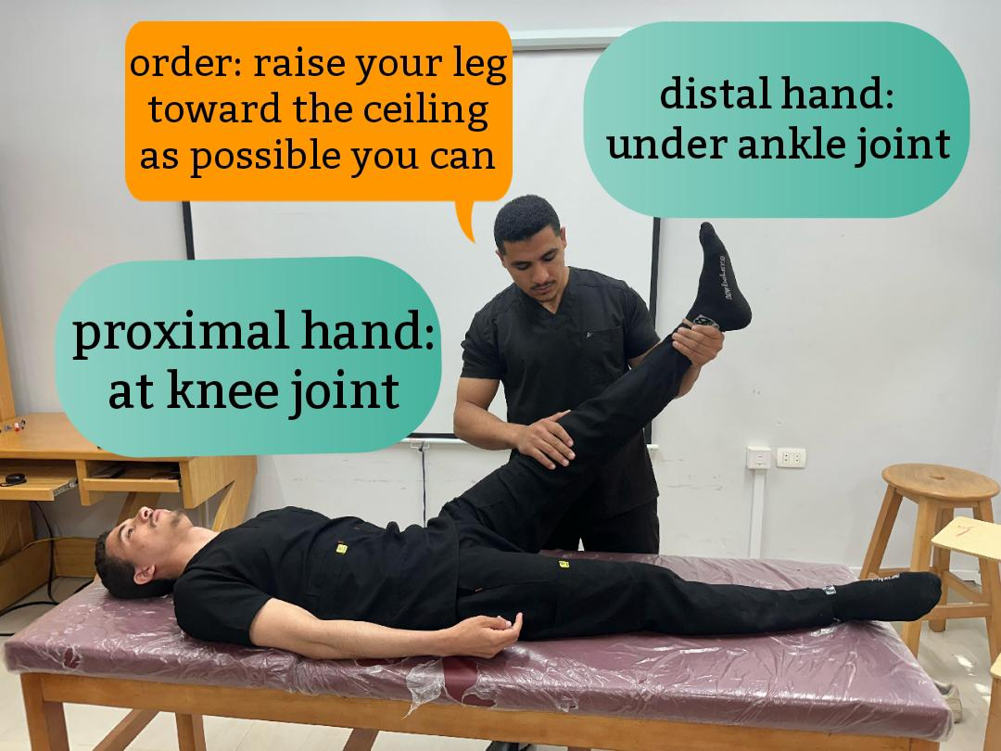
Sufficient AAROM
Patient make movement voluntary
Provide assistance when limitation in ROM
ONLY at the BEGINNING or the END of the ROM
when the effect of gravity has the greatest moment arm)torque(
Patient grade2 muscle test for strength muscle use AAROM against gravity, patient will make partial ROM then therapist Assist limb to end of ROM
grade1 muscle test patient for strength muscle use AAROM omitting gravity
With normal muscle condition use resisted AROM

Slide 5
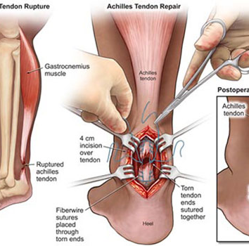
INDICATION
muscle weakness which occurs due to
neurological disease)multiple scerlosis(
chronic pain)complex regional pain syndrome(
B . when body levers are too weak to bring amovement or the muscle are too weak to control
the movement adequately. For Example :
movement: Standing on tiptoes Muscle involved: Gastrocnemius and soleus , Planterflexion Lever components: Fulcrum: Metatarsophalangeal joints . Load: Body weight Effort: Calf muscles pulling on the heel via Achilles tendon

Slide 6
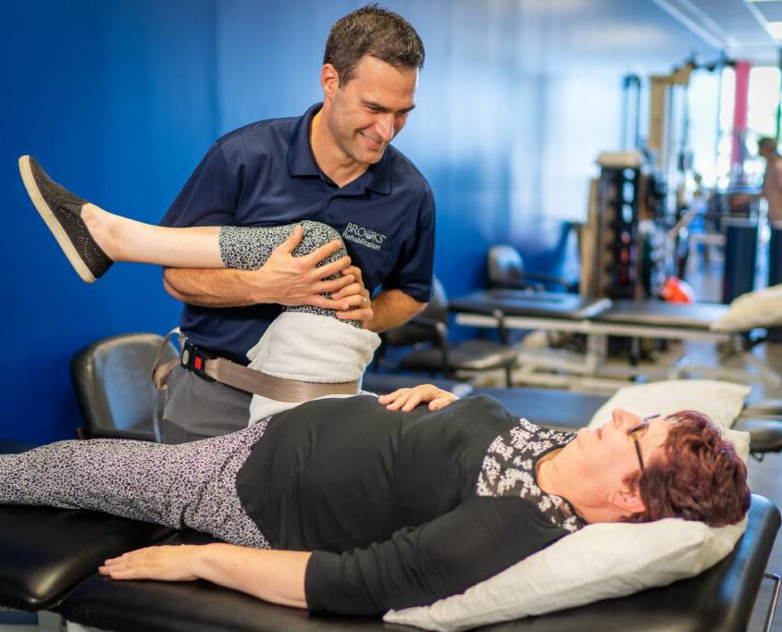

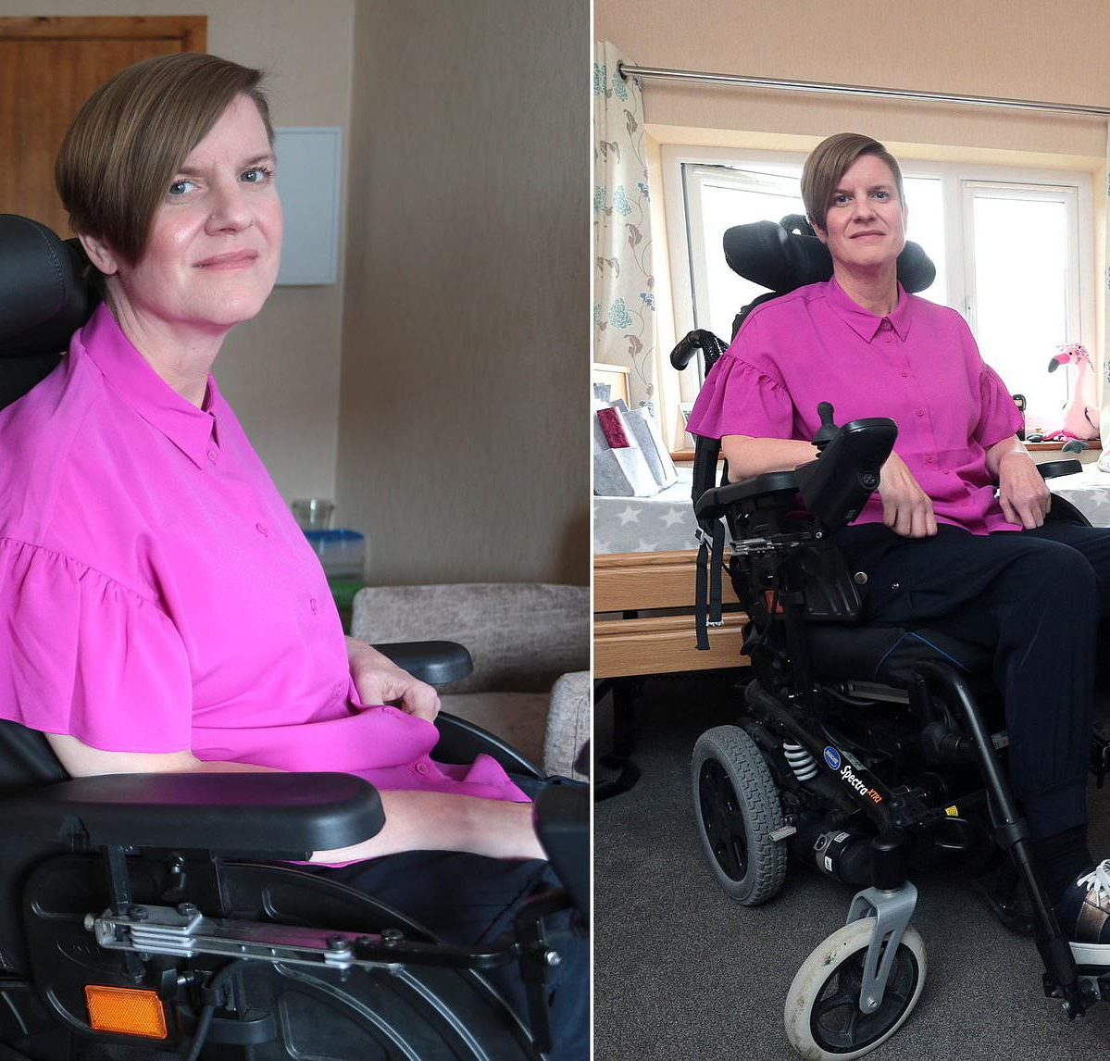
MULTIPLE SCERLOSIS
chronic CNS autoimmune disease (CNS) immune system mistakenly attacks myelin, causing inflammation and damage. Causing disrupts communication between brain and body part Symptoms: Numbing Tingling Muscle weakness
Types of MS include: Relapsing-remitting MS (RRMS): most common flare-ups followed by periods of recovery.
Secondary progressive MS (SPMS): follows RRMS involves gradual worsening over time
Primary progressive MS (PPMS): symptoms worsen gradually without relapses.
Effective goals of AAROM appear with RRMS
No cure, but treatments can manage symptoms, reduce relapses, slow progression.

Slide 7
Types of AAROM
SELF ASSISTED ( Manual – Equipment )
MECHANICAL ASSISTED
THERAPIST ASSISTED

Slide 8
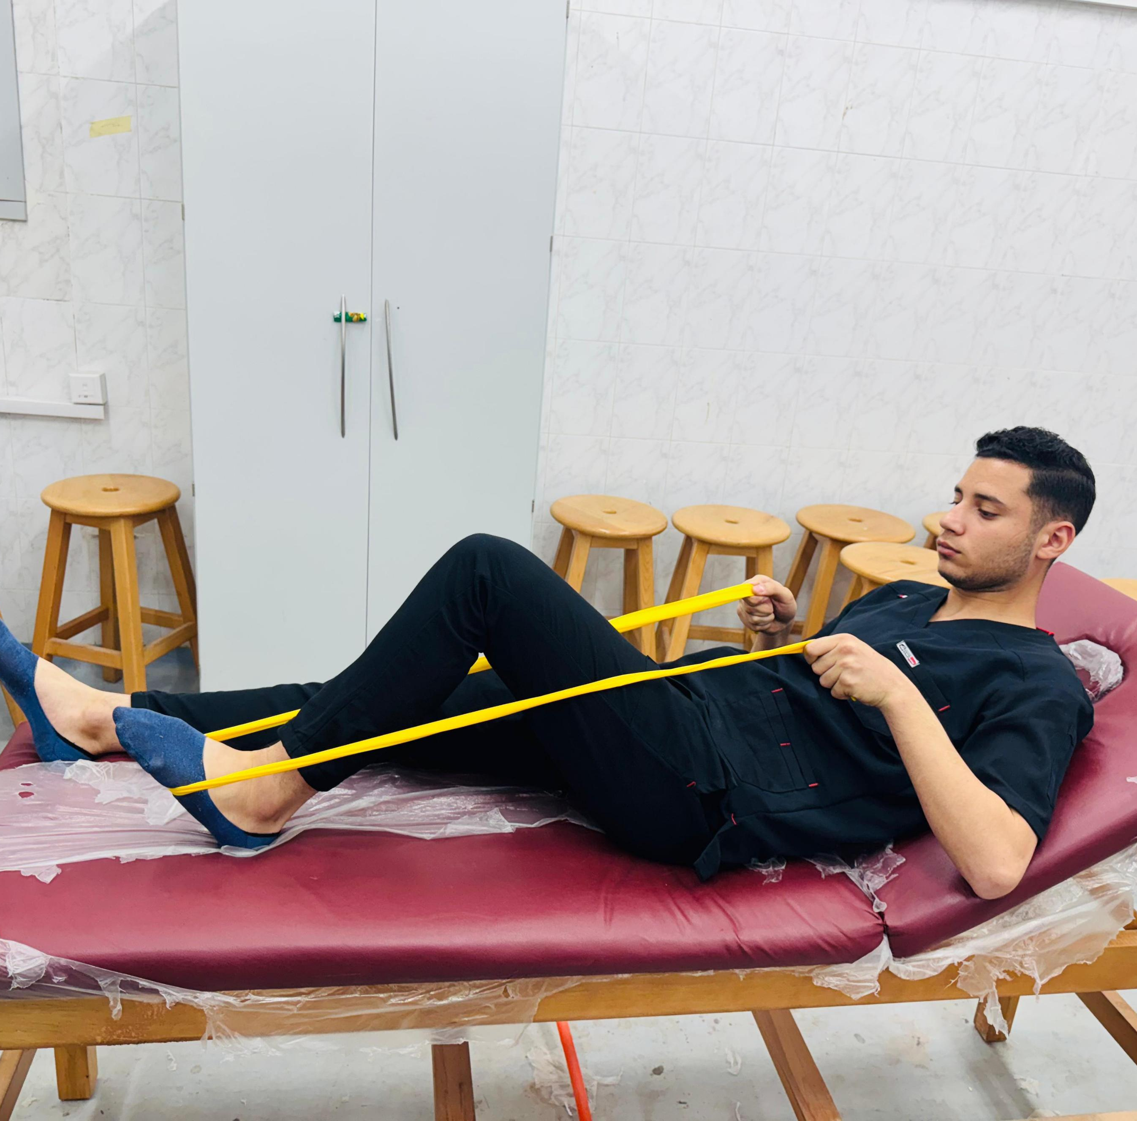
SELF ASSISTED
(1Heel Slide (Knee Flexion/Extension)
Equipment: Towel OR Resistance band
Starting Position: Supine or long sitting,legs extended.
Instructions:
.1Bend one knee slowly by sliding your heel toward your buttocks along the surface
2. Use a towel above ankle or at foot sole to gently assist the movement if the leg can't reach full ROM.
3. Hold the towel position for 3–5 seconds.
4. Slowly straighten the leg back to the starting position

Slide 9
SELF ASSISTED
A 40-year-old TAILOR presents with persistent
myalgia and fatigue in his right hip region following a direct injury to (ASIS) three months ago. He reports difficulty performing his ROUTINE WORK, which essential to his tailoring work. The pain worsens with prolonged activity and is accompanied by a sensation of weakness in the hip. On examination, TENDERNESS is noted over the ASIS, and Trendelenburg sign is NEGATIVE on affected side.

Slide 10
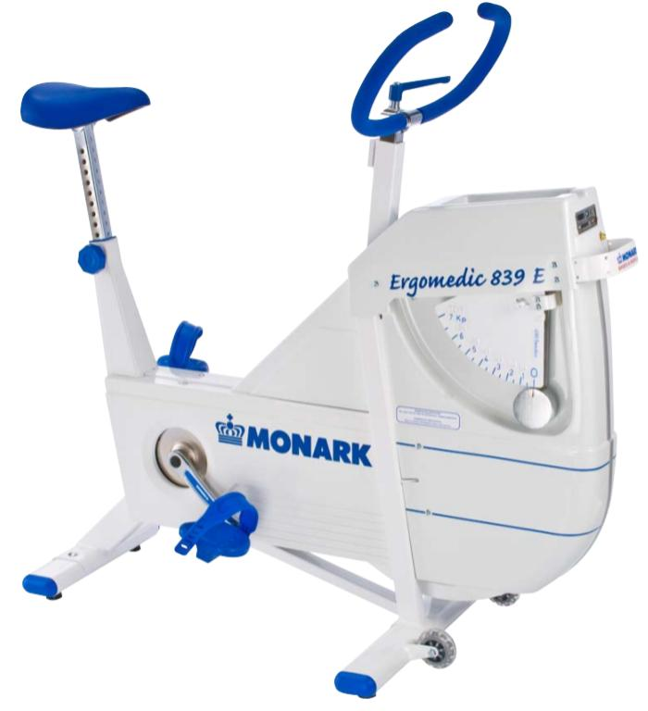
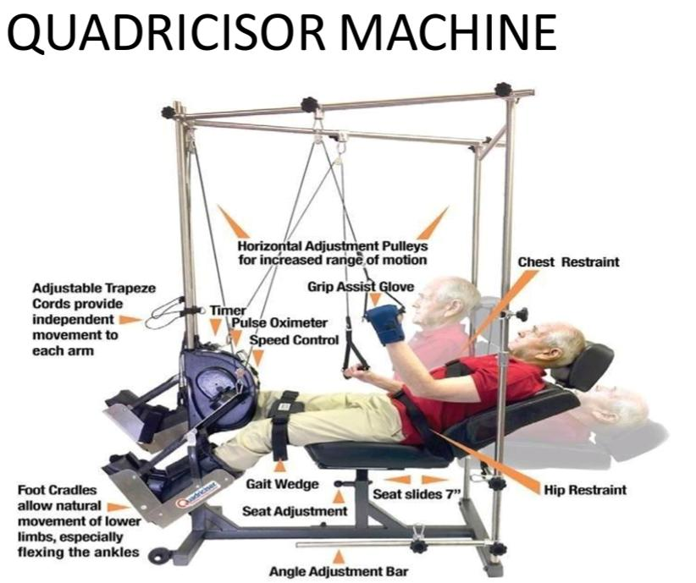
MECHANICAL ASSISTED
QUADRICISOR MACHINE
Like cycle ergometer
Patient assist the motion by pulling with his hands
May use to Passively movement of upper and lower extremity.

Slide 11
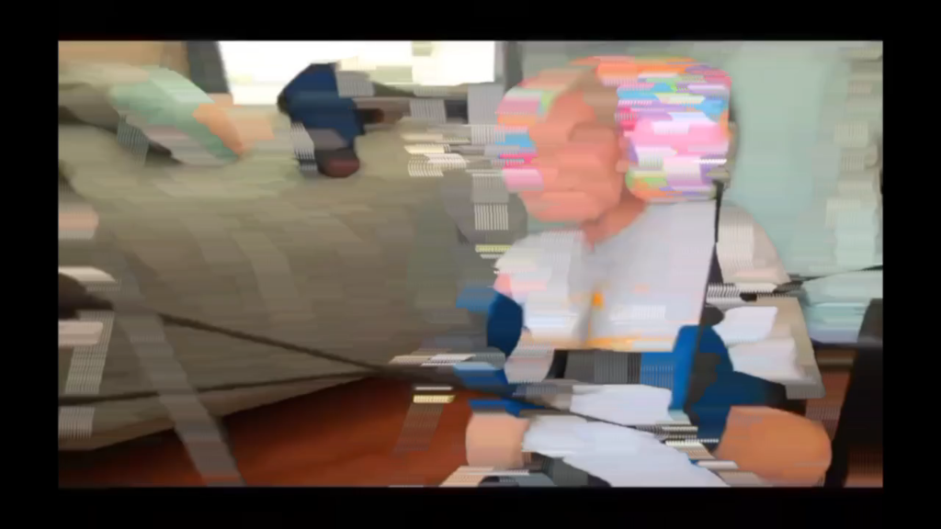
MECHANICAL ASSISTED

Slide 12
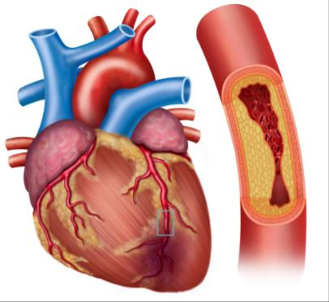
CONTRAINDICATION
immediately after acute tear ,fracture and surgery
motion is disruptive to the healing
After myocardial infarction and coronary artery by pass surgery
Additional trauma to the treated part
increased pain and increased inflamation

Slide 13
THERAPIST ASSISTED
35-years-old man suffer from a difficulty in gait particularly during early Stance phase from
initial contact to loading response and accompained by leaning trunk backward on the right side on assessment of the muscle strength by manual muscle test we found that grade is (2/5)

Slide 14
THERAPIST ASSISTED
42-year-old woman presents complaints of difficulty walking and pain in her right hip from 6 months especially when she walks long distances. On examination she asked to stand on her right leg while lifting her left leg off the ground. You observe that her left pelvis drops. When walking, a noticeable “hip drop” occurs on the lift side during the stance phase of the right leg. Neurological exam reveals normal sensation and reflexes.

Slide 15
QUESTIONS

Slide 16
Q: Which is indication for AAROM
Acute Pain
Complex regional pain
Cardiac infraction
Paralyzed limbs
🤔⁉️

Slide 17
Q: manual self assisted inversion
position is…… and for strength which muscle
Prone – tibialis posterior
Side lying – hamstring
Sitting with crossed leg – tibialis anterior
Supine – Sternocleidomastoid
🤔⁉️

Slide 18
CASE STUDY
35years-old football player had an direct truma in calcaneus lead to 3mm tear in Achilles tendon, and he had a surgery to and post-surgical for 4 months and CPM and manual passive movement he Shawn a G(1/5) he wanna to improve his muscle strength quickly Neurological exam reveals normal sensation and reflexes. Q1: which movement and muscle is effected ?
Q2: how to use AAROM to strength this muscle from G1/5 to G2/5 ? (Omitting gravity OR Against gravity ( ? And name the position.
Q3: choose electrotherapy modality to this condition
A.TENS B.Russian C.Farradic D.Microcurrunt

Slide 19

SCAN OUR WEBSITE
موقع خاص بنا،صممه ENG. Omar sami
فيديو من تصميمنا عن جميع حركات AAROM LL
كتاب من تصميمنا لجميع الحركات pdf
امكانية تحميل الفيديو و الملف على الهاتف Download
Website Link https://omarsamei.github.io/PHYST/

Slide 20
THANK YOU

